Slide 1
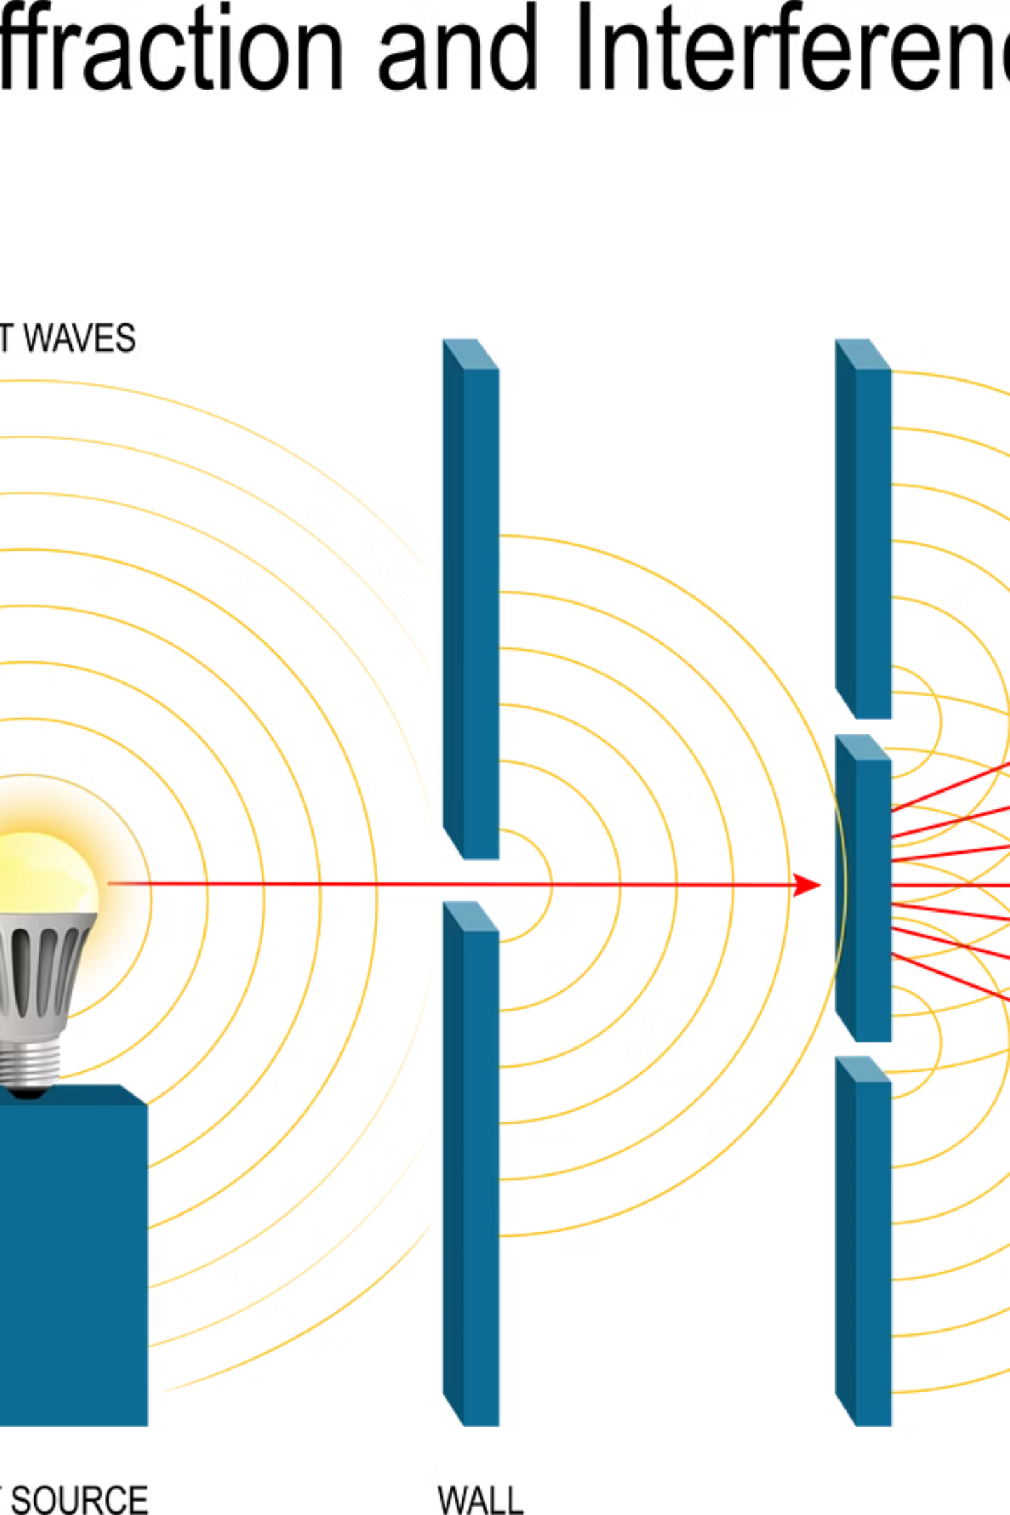
Young's Double-Slit Experiment
A foundational experiment that irrevocably changed our understanding of light and matter.
Presented by: M. Rehan (25F-CY-102), Cybersecurity Department

Slide 2
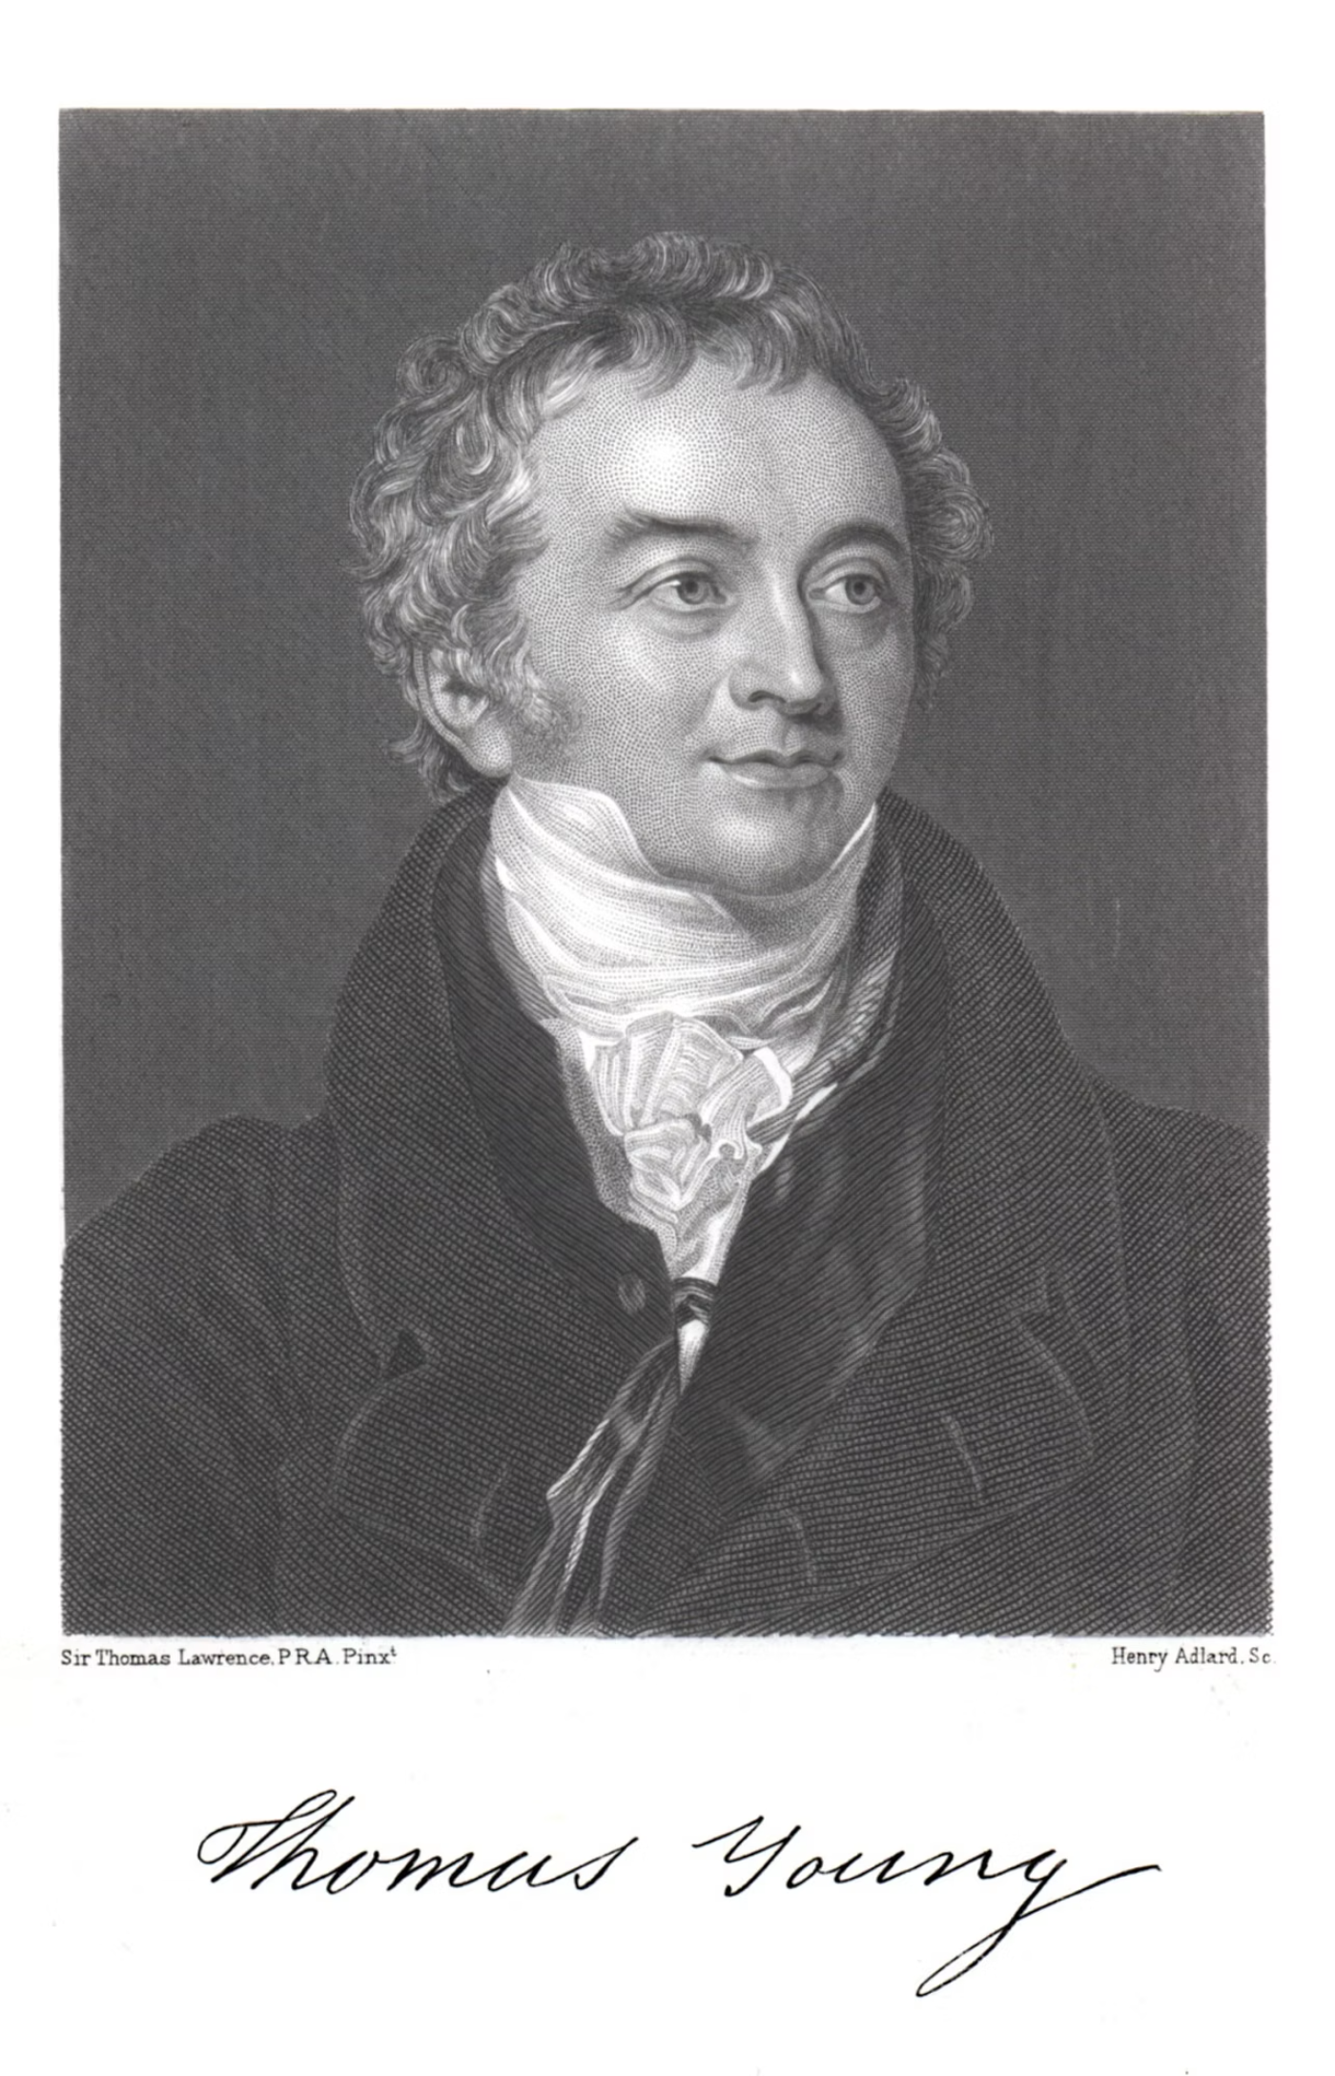

The Legacy of Thomas Young: Aim and Context
The Prevailing View (17th - 18th Century)
At the time of Thomas Young's experiments (around 1801), the dominant view, championed by Isaac Newton, held that light consisted of small, rigid particles or corpuscles. This model explained reflection and refraction well.
The Central Question Young's primary objective was to definitively determine the nature of light: Is light a stream of particles (corpuscles) or is it a wave phenomenon? His simple yet ingenious experiment provided compelling evidence for the wave theory.
Key Insight: Only waves are capable of producing stable, sustained interference patterns when two coherent sources interact.

Slide 3
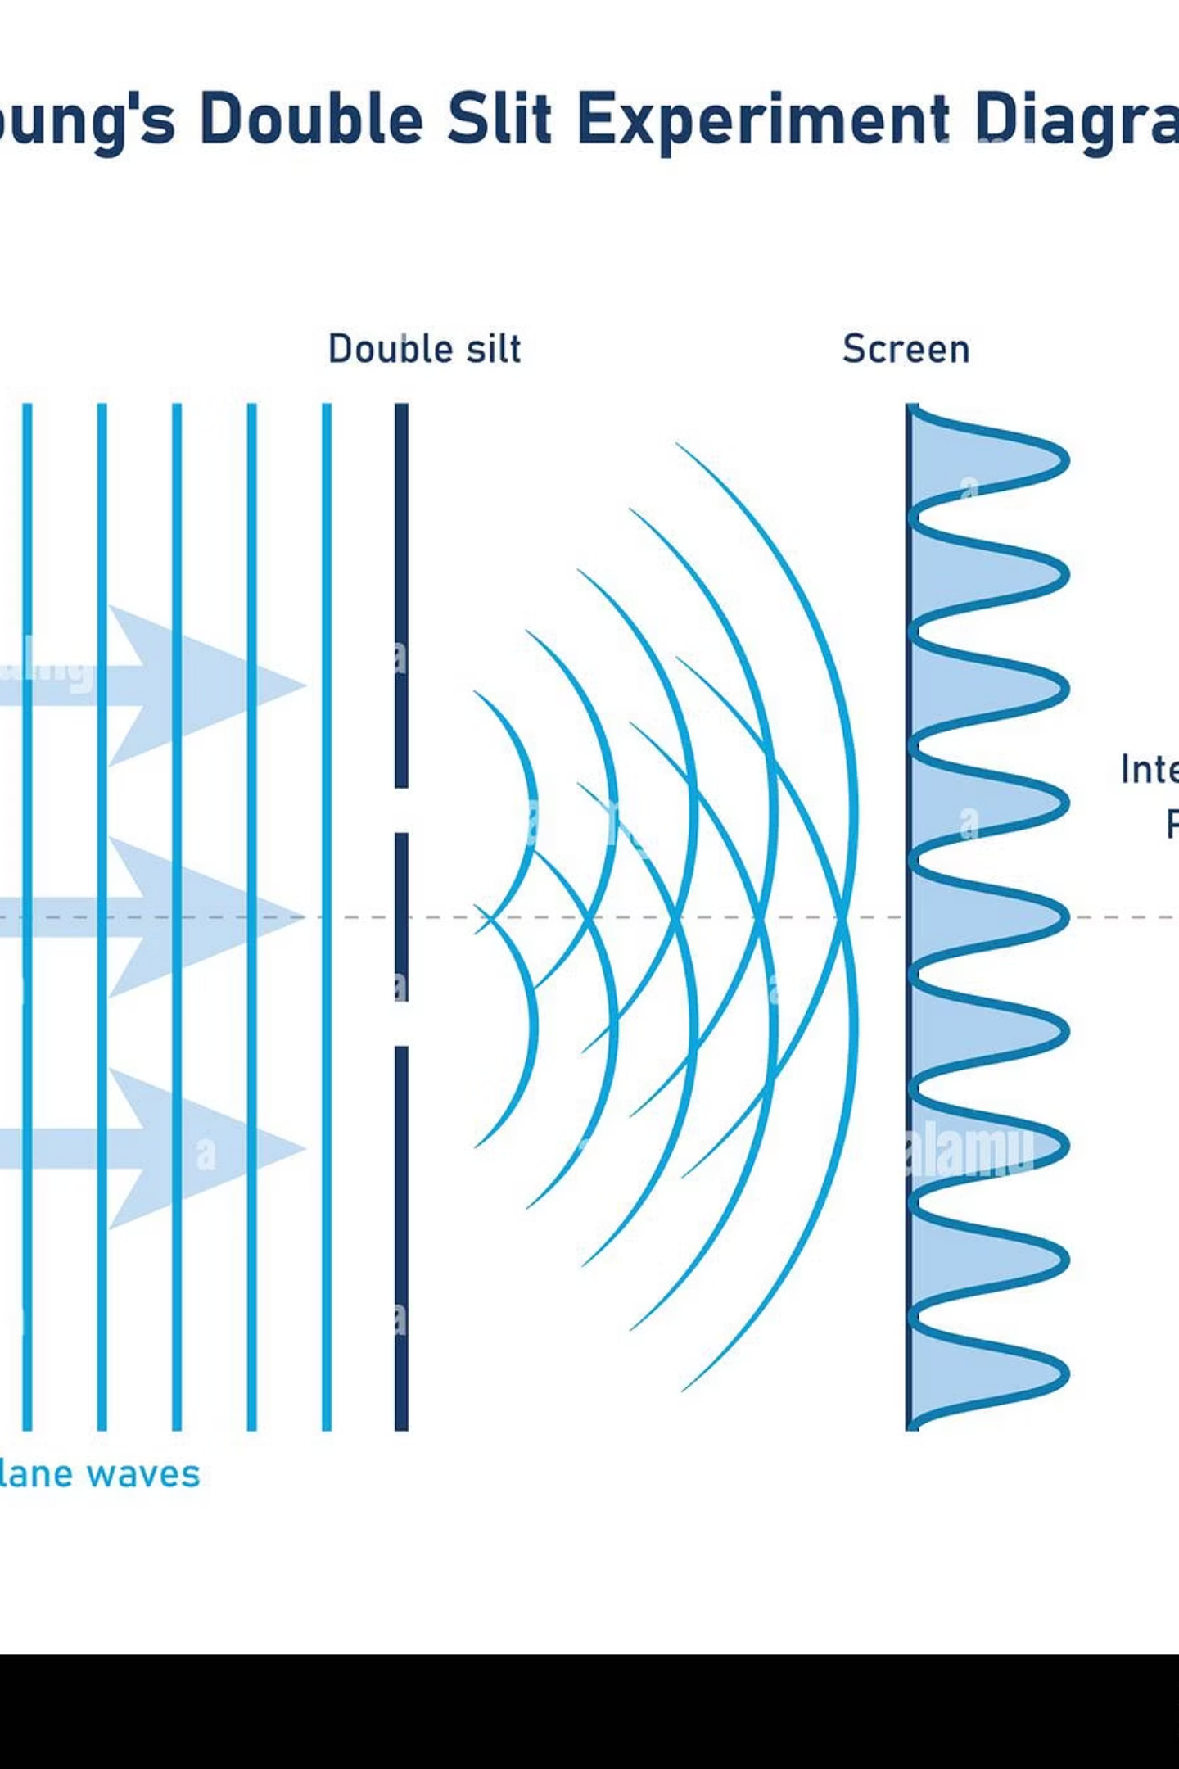
Experimental Setup: A Simple, Elegant Design
Source (S)
A single, monochromatic light source ensures a constant frequency and wavelength (coherence).
Single Slit (S₁)
A narrow slit diffracts the light, creating a wavefront that illuminates the double-slit screen uniformly.
Double Slit (d)
Two parallel, closely spaced slits (distance 'd') act as two new coherent sources of light waves.
Detection Screen (L)
A screen placed a distance 'L' away, where the resulting pattern is observed.
The crucial parameters are the slit separation (d), the distance to the screen (L), and the resulting fringe separation (Δy).

Slide 4
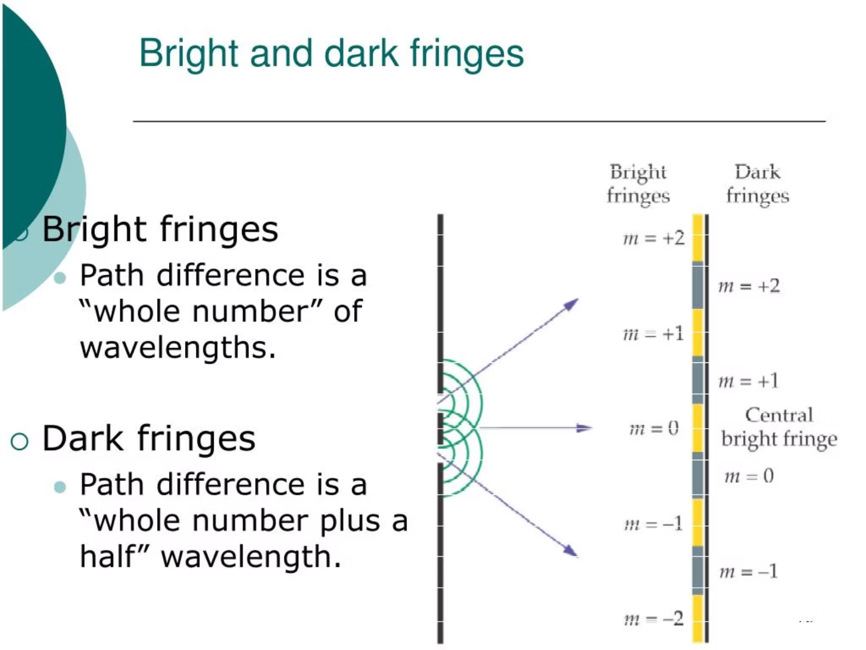
Observation 1: The Interference Pattern
The Result: Alternating Bright and Dark Fringes
When light passes through the two slits, it does not simply form two bright lines as particles would. Instead, an alternating pattern of bright (constructive) and dark (destructive) bands appears on the screen.
This outcome is the hallmark of wave behavior. It demonstrates that light waves interfere with one another.

Slide 5

Observation 2: Constructive and Destructive Interference
Constructive Interference (Bright Fringes)
Destructive Interference (Dark Fringes)
Occurs when the path difference (Δx) between the two waves is an integer multiple of the wavelength (λ).
Occurs when the path difference (Δx) is a half-integer multiple of the wavelength (λ).
At bright fringes, the waves arrive in phase, resulting in maximum amplitude; at dark fringes, they arrive exactly out of phase, resulting in zero amplitude.

Slide 6
Derivation of the Interference Equation
We use geometry based on the path difference (Δx) and the small angle approximation for the observed angle (θ) to derive the positions of the fringes.
1
2
3
Geometric Relation
Angular Position
Combining Terms
For very small angles, the path difference is approximated as: \Delta x \approx d \sin\theta.
The position y on the screen is related by: \sin\theta \approx \tan\theta \approx y / L.
Substituting the approximations into the constructive condition (\Delta x = m\lambda) gives the position of the m-th bright fringe:
Where: yᵤ is the position of the fringe, m is the order number, λ is wavelength, L is screen distance, and d is slit separation.

Slide 7
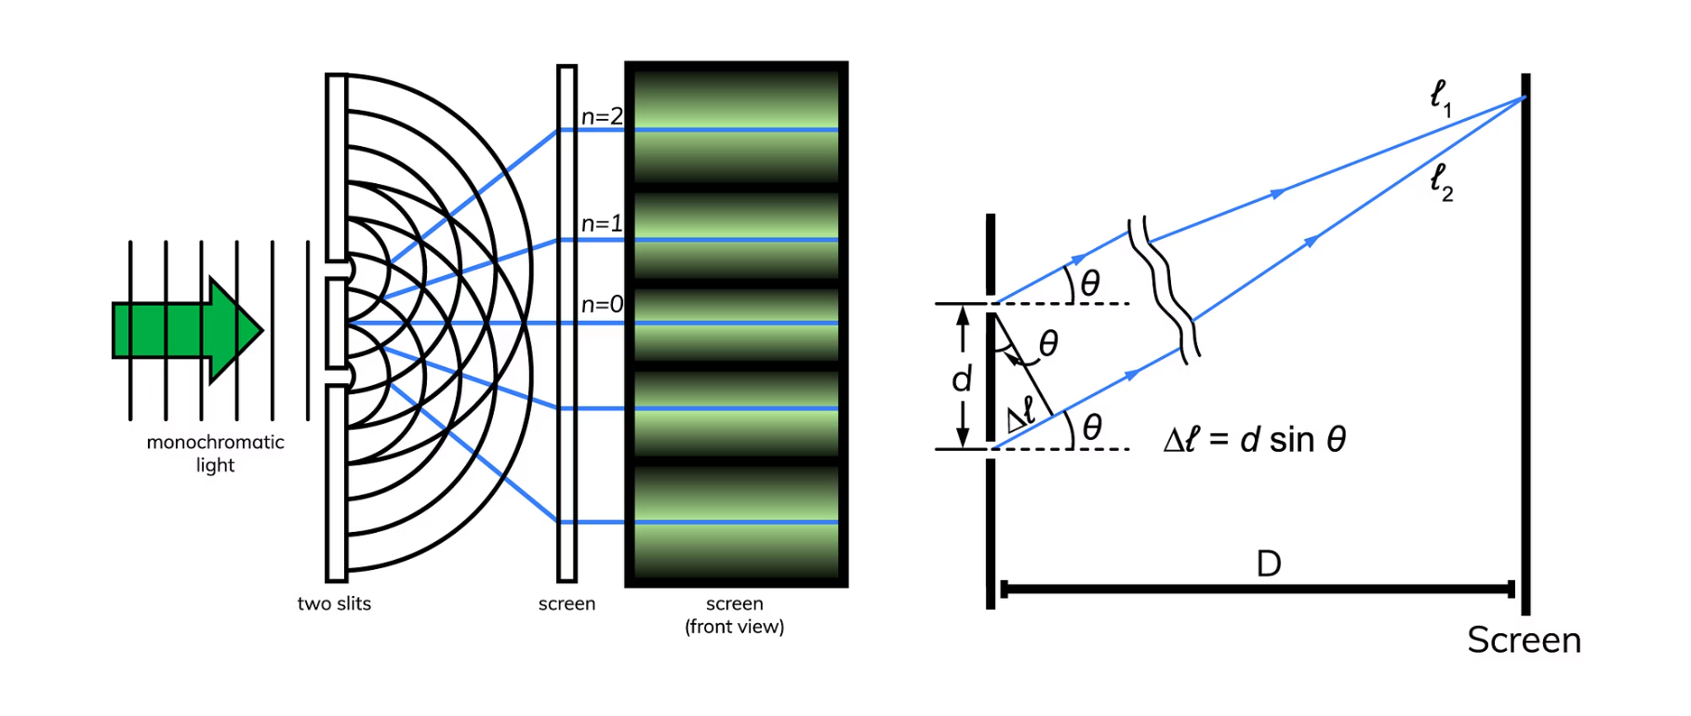

Calculating Fringe Separation (Δy)
The Key Measurable
The fringe separation (Δy) is the distance between two consecutive bright (or dark) fringes. This distance remains constant across the pattern.
By calculating the difference in position between the m-th and (m+1)-th bright fringes:
\Delta y = y_{m+1} - y_m = \frac{(m+1) \lambda L}{d} - \frac{m \lambda L}{d}
This equation allows us to calculate the wavelength of light (λ) from simple measurements (Δy, L, d), confirming its wave nature.

Slide 8
From Wave Theory to Quantum Duality
Young's experiment was initially proof of light's wave nature, but its true revolutionary potential emerged a century later in quantum mechanics.
01
02
Light as Waves
Light as Particles (Photons)
The 19th century accepted the wave model of light, explaining interference and diffraction perfectly.
Einstein’s work on the photoelectric effect confirmed that light also behaves as discrete energy packets (photons).
03
04
The Revolutionary Step
Wave-Particle Duality
When single electrons (particles!) were fired through the double slits, they still produced an interference pattern.
The experiment became the definitive demonstration of quantum mechanics: all matter and energy exhibit both wave and particle characteristics.

Slide 9
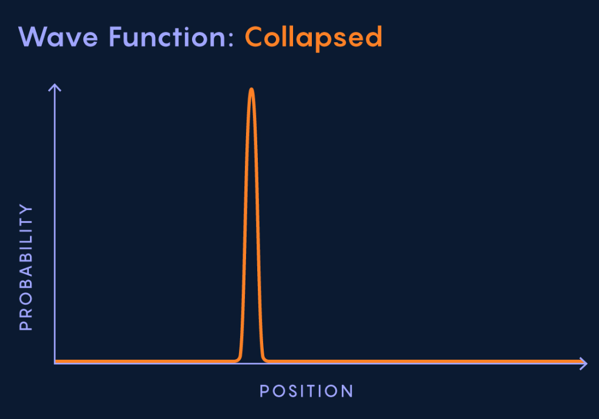
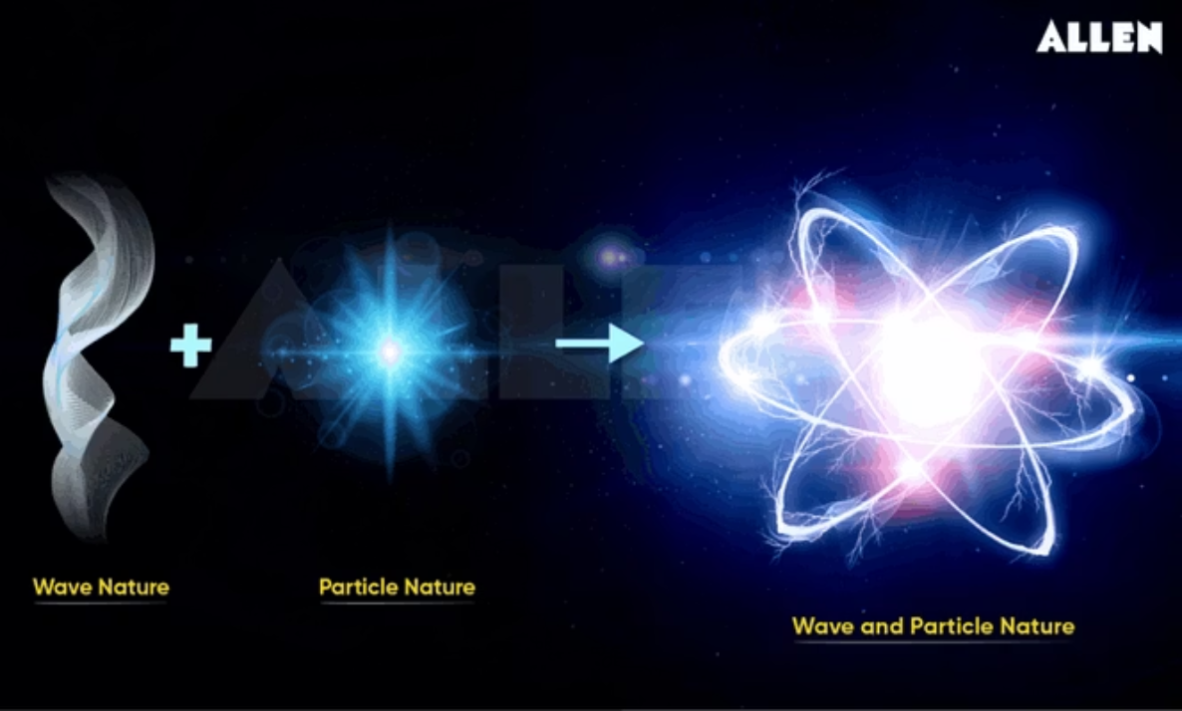
The Mystery of Observation
The quantum version of the double-slit experiment introduced profound paradoxes concerning observation and reality.
When electrons are fired one by one, they still build up an interference pattern over time, suggesting the particle interferes with itself (it travels as a wave of probability).
If a detector is placed at the slits to observe which slit the electron goes through, the interference pattern immediately collapses, and the electrons behave like classical particles (two lines).

Slide 10



Key Takeaways: A Pillar of Modern Physics
Confirms Wave Nature
Defines Duality
Impact of Observation
Its adaptation with electrons established the principle of wave-particle duality for all quantum objects.
Young's original experiment provided irrefutable evidence for the wave theory of light via interference.
It highlighted that the act of observation fundamentally changes the state and behavior of a quantum system.
“The experiment that cannot be explained classically, and holds the key to the entire mystery of quantum mechanics.” – Richard Feynman

